Slide 1


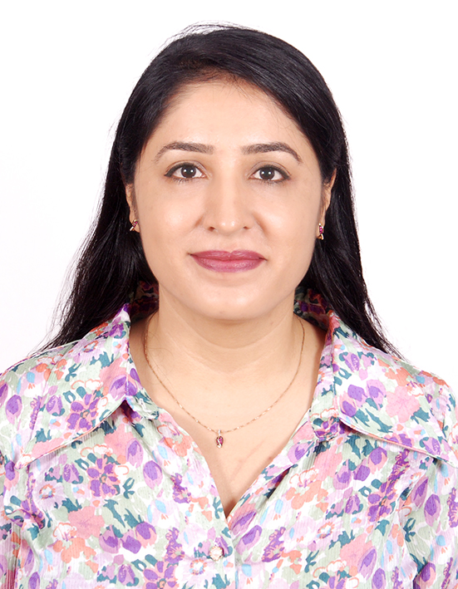
Rinky Sharma
(91) 9036-102-699 rinkysharma7@deloitte.com
Profile
Results-driven Senior Consultant Data Engineer with 9+ years of experience delivering large-scale data solutions, leading strategic data initiatives, and architecting scalable reporting platforms. Proven expertise in ETL development, data modeling, cloud data platforms (GCP), and business intelligence. Adept at stakeholder engagement, mentoring teams, and driving cost optimization through technical innovation. Recognized with multiple client awards for impact and excellence.
Illustrative Experience :
HealthCare Client– Data Engineering Lead:
Spearheaded reporting and data engineering for the DSCSA compliance module, ensuring regulatory alignment and stakeholder visibility. Designed scalable data models in BigQuery to support serialized reporting, vendor scorecards, and lot-level tracking.
Acted as the primary point of contact for reporting-related incidents; ensured timely resolution and minimal disruption. Collaborated cross-functionally to deliver accurate, timely, and audit-ready data solutions.
HealthCare Client– Data Engineering Lead:
Architected the end-to-end solution stack spanning data engineering, data analysis, and visualization, enabling accurate and scalable supply chain reporting across multiple regions and product categories.
Implemented advanced cache strategies that reduced duplicate queries by 40%, saving ~$2K annually; this optimization was recognized by the client and rolled out across other teams for org-wide efficiency gains.
Finance Client - Data Engineering Lead :
FDU (Financial Data Unification): Led a 6-member team through Phase 2 closure, delivering 50+ report changes post-GoLive and establishing a reconciliation framework for all delivered objects to ensure data accuracy and audit readiness.
RAR (Revenue Recognition, Accounting & Reporting): Directed a 5-member team to set up ETL and reporting pipelines from scratch, authored 8+ data models and multiple reports, and partnered with client/functional teams to resolve requirement ambiguities. As IC, delivered 1 critical data model and 2 reports.
Concord: Assumed full project management responsibilities in the absence of a lead, successfully driving developments to completion without timeline slippage; delivered 2 critical data models and reports while stabilizing existing assets by resolving testing bugs.
Oversaw task assignment, code reviews, and documentation, reviewing 100+ changes and instilling quality-first engineering practices
Drove strategic dashboard initiatives delivering insights across core Google products including Android, Google Play, Chrome, Google TV, and Chromecast, enabling leadership to monitor product health, user behavior, and market trends.
Education
B. Tech: Computer Science- India
Office:
Bangalore, India
Industries:
Healthcare
Finance
Certifications:
Google Cloud Data Engineer
Google Cloud Data Architect
Skills:
GCP(SQL, BQ, Dataflow, Cloud Storage, Dataproc etc.)
Reporting : Looker, Looker Studio, Google PLX
Python

